Slide 1
Getting started with Cypress

Slide 2
What is cypress?
Javascript testing framework that runs within browser
Notes:
Time: 2-3 mins

Slide 3
Does it use selenium?
No, it does not use selenium

Slide 4
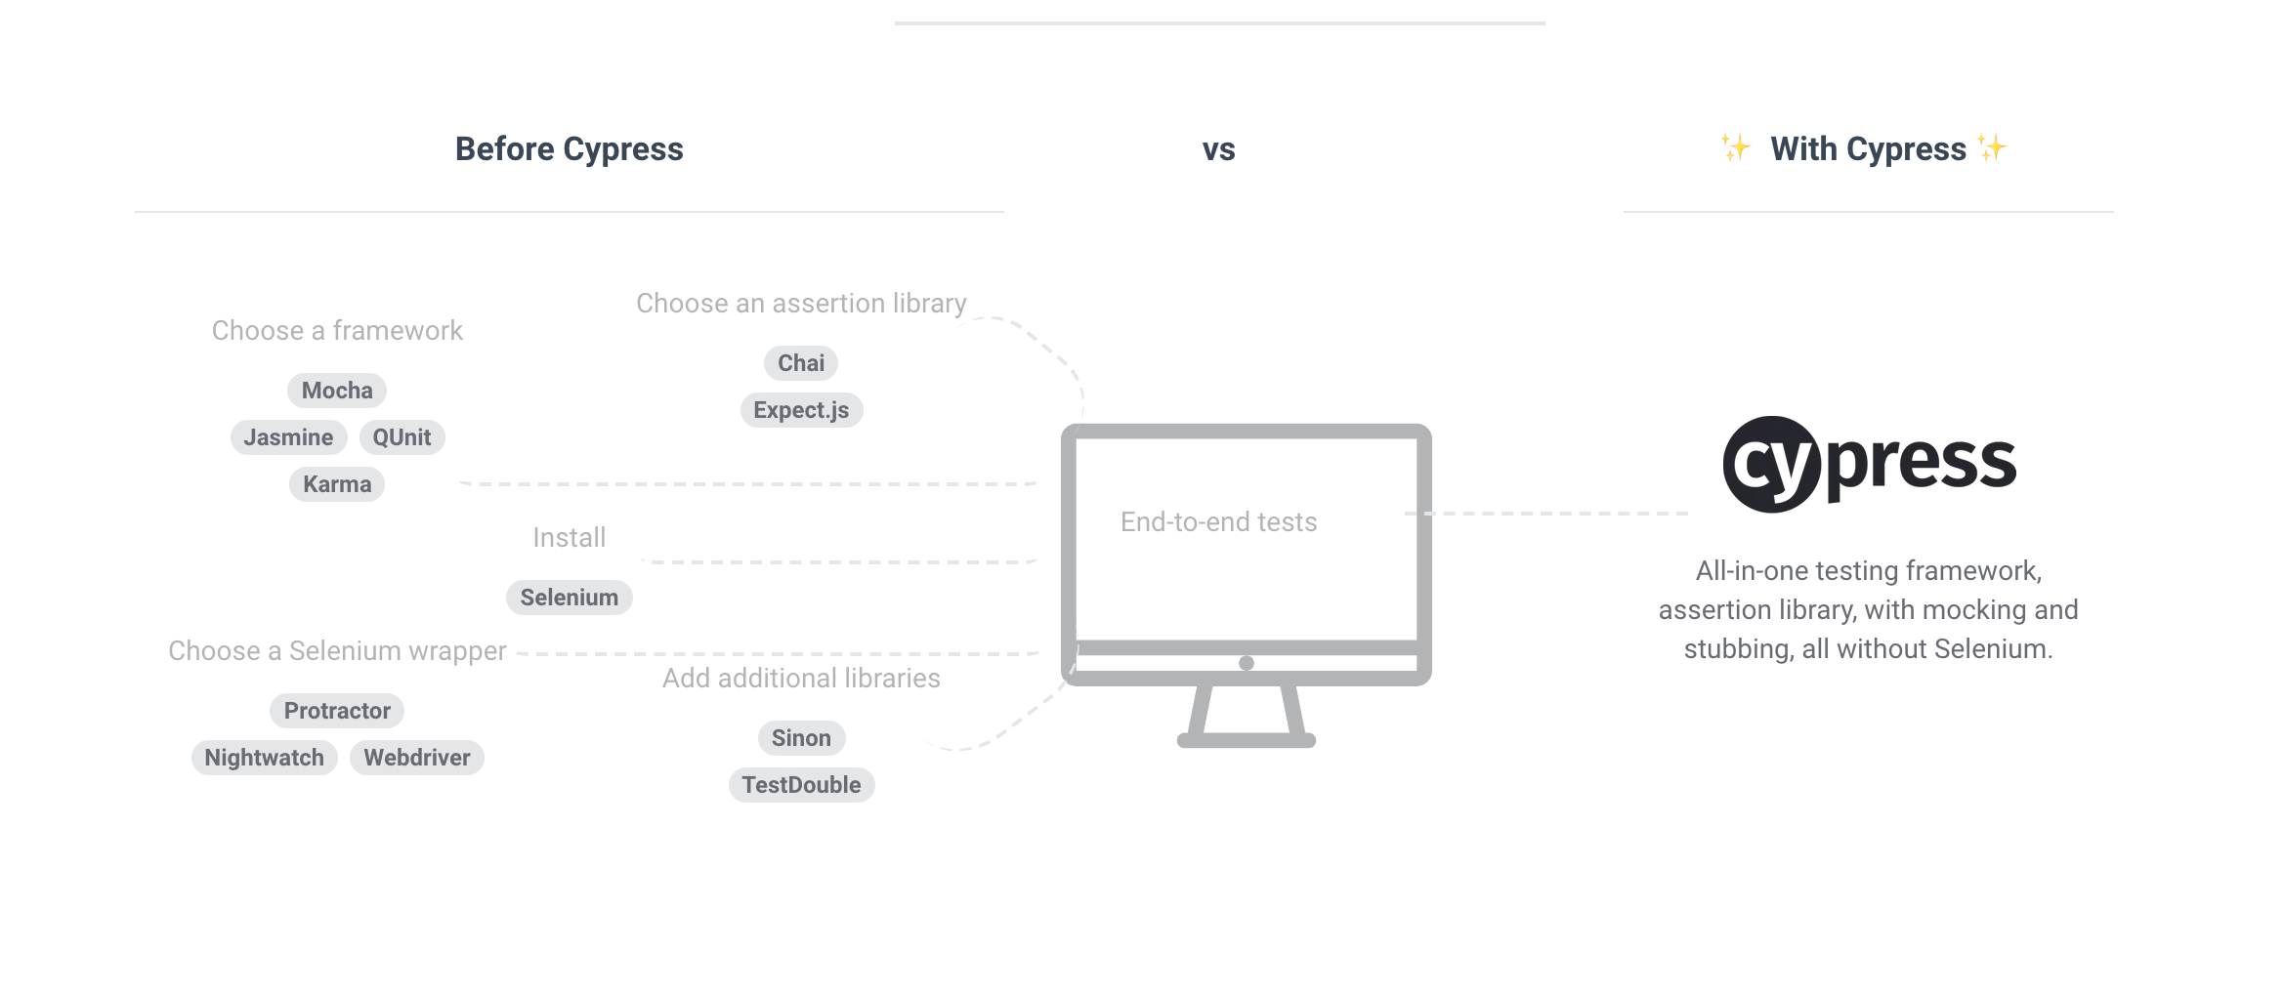
How does it work?
Image via https://www.cypress.io/how-it-works/
Notes:
Time-5 mins

Slide 5
Why Cypress?
Easy to get started
All in one testing tool
Reliable tests
Faster tests
Automatic waits
Easy debugging
Screenshots and videos of tests
Notes:
Time-5 mins

Slide 6
Installation
Step 1: npm install cypress
Hola!! Its done :)

Slide 7
Demo
Writing a test with cypress

